Slide 1

Beyond Institutions: Personal Learning in a Networked World
  London School of Economics ( 9th July, 2014)
  Stephen Downes
Notes:
http://clt.lse.ac.uk/events/NetworkEDGE/networkEDGE-seminar-series-01.php
In a networked world people become less and less dependent on institutional learning begin to and begin to create their own learning. This creates challenges for institutions, but it also creates challenges for students. In the past, personal learning has been represented as a form of autodidacticism where students either read books at random in the library or at best studied programmed education texts and videos. Today personalized learning is supported using adaptive learning and interactive digital resources. Neither offers what we would call a complete learning experience, as we know there is a social and supportive dimension that must be included. The challenge is to design learning systems that are supportive without asserting control, providing access to a wide range of resources from multiple institutions, but in addition, scaffolding frameworks, access to social and professional networks and support though personal and mobile computing devices, devices and tools, and in workplace systems generally. In this talk Stephen Downes discusses developments in a personal learning infrastructure and outlines how professionals, as both teachers and learners, can take advantage of them.

Slide 2

Economics students are calling for a shakeup of the way their subject is being taught
“The dominance of narrow free-market theories at top universities harms the world's ability to confront challenges such as financial stability and climate change”
http://www.theguardian.com/education/2014/may/04/economics-students-overhaul-subject-teaching
Notes:
Economics students call for shakeup of the way their subject is taught
Phillip Inman, The Guardian, May 08, 2014
Commentary by Stephen Downes
The students, I think, understand more than their professors. Economics students are saying that "the dominance of narrow free-market theories at top universities harms the world's ability to confront challenges such as financial stability and climate change" and are calling for a change in how economics is taught. "The crisis has laid bare the latent inadequacies of economic models. These models have failed to make sense of the sorts of extreme macro-economic events, such as crises, recessions and depressions, which matter most to society." Not to mention things like climate change and pervasive surveillance, to name a couple. Here is the students' manifesto. Via Sheri Oberman (thanks!)

Slide 3
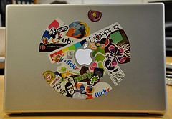
Professors meanwhile are still trying to ban laptops from the classroom
Dan Rockmore: “Our “digital assistants” are platforms for play and socializing”
The study (comparing taking notes by typing and by hand) should be rejected as irrelevant
Rockmore: http://www.newyorker.com/online/blogs/elements/2014/06/the-case-for-banning-laptops-in-the-classroom.html
Talbert: http://chronicle.com/blognetwork/castingoutnines/2014/06/13/three-issues-with-the-case-for-banning-laptops
Notes:
Three issues with the case for banning laptops
Robert Talbert, The Chronicle: Casting Nines, Jun 17, 2014
Commentary by Stephen Downes
I am often present in meetings and sessions where the request is made that people close their laptops. I don't do it. For me, the laptop is the machine I use to help me think; I engage with the ideas being presented in real-time, and create a record I can search and integrate into later work. So I wasn't persuaded by the anti-laptop argument presented in the Atlantic last week. That said, the response to the article doesn't sway me either. I think that the study (comparing taking notes by typing and by hand) should be rejected as irrelevant. I think the characterization of a laptop as a work or a play tool is irrelevant (for me, my work is my play). And the laptop vs the lecture argument sets up a false dilemma.

Slide 4
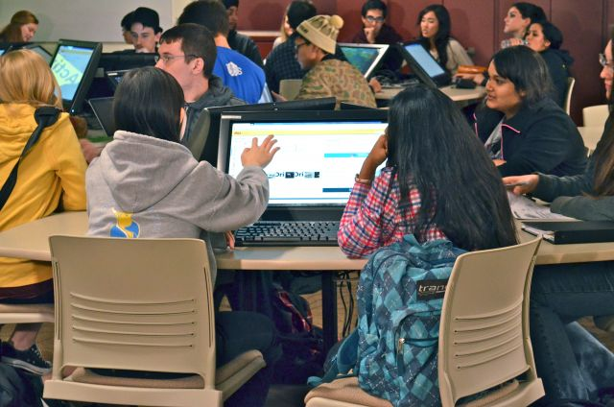
In fact, pretty much anything works better than the lecture method traditional institutions defend
A summary of 225 recent studies, "provides overwhelming evidence that active learning works better than lecture."
http://www.insidehighered.com/news/2014/05/13/stem-students-fare-better-when-professors-dont-just-lecture-study-finds#sthash.wxiT1GBS.dpbs
Scott Freeman Metastudy: http://www.pnas.org/content/early/2014/05/08/1319030111.full.pdf+html
Notes:
A Boost for Active Learning
Doug Lederman, Inside Higher Ed, May 14, 2014
Commentary by Stephen Downes
According to Scott Freeman, the metastudy he and his colleagues have published,which is in essence a summary of 225 recent studies, "provides overwhelming evidence that active learning works better than lecture." That may not mean that instructors stop lecturing, he said, "but it shouldn't be about the evidence anymore." Instructivists, over to you.

Slide 5
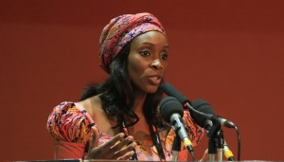
"Everyone knows that knowledge is growing at an increasing depth and an increasing breadth, so you need people which can constantly learn and bridge that gap even while they’re in their current jobs." Iyadunni Olubode
http://www.elearning-africa.com/eLA_Newsportal/elearning-africa-keynote-plenary-sessions/
Notes:
eLearning Africa’s memorable keynote quotes
Various authors, eLearning Africa News, Jun 25, 2014
Commentary by Stephen Downes
Nice quick summary of the key messages from the eLearning Africa keynotes, and a quick snapshot of thinking from the conference. For example: "Everyone knows that knowledge is growing at an increasing depth and an increasing breadth, so you need people which can constantly learn and bridge that gap even while they’re in their current jobs." Iyadunni Olubode, Executive Director, LEAP Africa Ltd/Gte., Nigeria.

Slide 6

People are looking for learning that is relevant and practical
"students expect universities to be more accessible, flexible and focused on jobs, according to a new survey.“
Of course, it would help if we surveyed people and not just students
http://campustechnology.com/articles/2014/06/09/report-students-expect-future-universities-to-be-flexible-accessible-career-oriented.aspx
Notes:
Report: Students Expect Future Universities To Be Flexible, Accessible, Career-Oriented
Joshua Bolkan, Campus Technology, Jun 11, 2014
Commentary by Stephen Downes
According to this article, "students expect universities to be more accessible, flexible and focused on jobs, according to a new survey." This report will be reported without criticism (as it is in Campus Technology) but consider the source: "The "2014 Global Survey of Students" compiled responses from more than 20,800 students at 37 institutions in the Laureate network." I would imagine that if they surveyed 20K arts and humanities students at small liberal arts universities, the outcome would be rather different. We have to stop surveying 'university students' (and especially students from one particular institution) and start surveying 'people', whether or not they are in this or that institution.

Slide 7

Economists have their own view of what academia needs…
If the Economist says something is good, I begin to worry. And so too with this article touting the destruction of the universities at the hands of the MOOC.
http://www.economist.com/news/briefing/21605899-staid-higher-education-business-about-experience-welcome-earthquake-digital?fsrc=scn/tw_ec/the_digital_degree
Notes:
The digital degree
Unattributed, The Economist, Jul 01, 2014
Commentary by Stephen Downes
If the Economist says something is good, I begin to worry. And so too with this article touting the destruction of the universities at the hands of the MOOC. The Economist sees the elite universities faring well, with smaller for-profits and even medium-sized public universities bearing the brunt. I'd like to think that open online learning will make the elite universities irrelevant - of course, a lot of things have to happen for that to take place, but we can always hope.

Slide 8
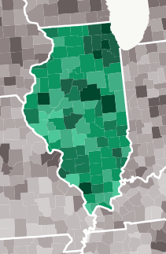
Three trends ‘worth watching’ in the higher education space:
Tiered service models at universities
Analytics and data-driven management
Alternative credentials
Economics and education – two domains in which models prevail
http://higheredtoday.org/2014/05/05/three-trends-worth-watching-for-continuing-education-leaders/
Image: A Stronger Nation Through Higher Education,” Lumina Foundation, 2013. Accessed at http://www.luminafoundation.org/stronger_nation/report/
Notes:
Three Trends Worth Watching for Continuing Education Leaders
Cathy Sandeen, Higher Education Today, May 29, 2014
Commentary by Stephen Downes
All three of these trends are very likely, I think. Here's the list:
Tiered service models at universities
Analytics and data-driven management
Alternative credentials
To a certain degree, all of these are already present in institutions or in learning technology; what we will probably see over the next few years is widespread adoption.

Slide 9
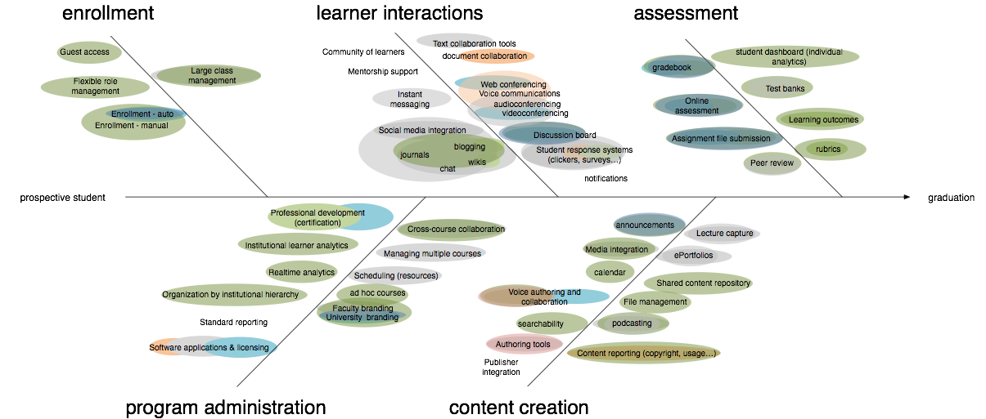
A model of the workflow process employed to assist LMS selection
http://darcynorman.net/2014/05/16/cnie-session-on-campus-engagement/
Notes:
CNIE session on campus engagement
D'Arcy Norman, D'Arcy Norman dot net, May 27, 2014
Commentary by Stephen Downes
From the recent CNIE conference D'Arcy Norman shares "some of the campus engagement stuff we did as part of our long LMS replacement project. I tried to stay away from the technology itself, and focus on the engagement process. Full slide deck is available online, and fuller reports describing the engagement and findings are still available online, as well as the GitHub repository of LMS RFP requirements1." I know that the CNIE conference came and went recently - is it me or is this conference beginning to change focus? It was seeming less relevant in recent years but the current one in Kamloops actually seems to be talking about technology and related issues.

Slide 10

A step-by-step guide to LMS selection; a customized list of LMS features
See also the appendix containing 305 questions or features to consider during the selection process.
http://www.educause.edu/ero/article/selecting-learning-management-system-advice-academic-perspective
Notes:
Selecting a Learning Management System: Advice from an Academic Perspective
Clayton R. Wright, Valerie Lopes, T. Craig Montgomerie, Sunday Reju, Seb Schmoller, EDUCAUSE Review, Apr 28, 2014
Commentary by Stephen Downes
It's a bit old school, but many institutions are still going through the LMS selection process. This article is a good guide. "This article stresses the importance of involving all stakeholders in the selection process, offers a step-by-step guide to LMS selection, and enables readers to develop a customized list of LMS features that align with their institution's instructional and learning priorities." See also the appendix containing 305 questions or features to consider during the selection process.

Slide 11

Learning design patterns via Grainne Conole
“see how a particular pedagogic approach can be migrated successfully across different topics”
http://learningdesigner.org/
Notes:
Learning Designer
Various authors, London Knowledge Lab, Apr 29, 2014
Commentary by Stephen Downes
The early-release version of the website is now available. "The Learning Designer suite of tools enables teachers to share their good teaching ideas. It is intended to help a subject teacher see how a particular pedagogic approach can be migrated successfully across different topics. There are sample patterns to browse and edit, or you can design your own from scratch." Via Grainne Conole, who says it was created by Diana Laurillard and others. Interesting to explore.

Slide 12
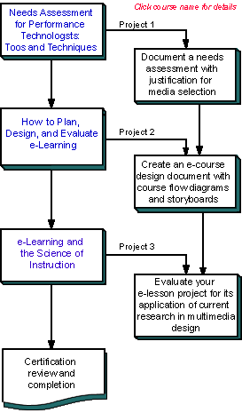
“Best Practices” for typical learning tasks
For example, the phenomenon of 'conditional release of material' - that is, showing students course content only after they have reached a certain threshold
http://jolt.merlot.org/vol10no2/fisher_0614.pdf
Image: http://www.clarktraining.com/eLearning.php
Notes:
Conditional Release of Course Materials: Assessing Best Practice Recommendations
Lawanna S. Fisher, Justin G. Gardner, Thomas M. Brinthaupt, Deana M. Raffo, MERLOT Journal of Online Learning and Teaching (JOLT), Jul 03, 2014
Commentary by Stephen Downes
This is a pretty interesting paper up to the end of page four. It discusses the phenomenon of 'conditional release of material' - that is, showing students course content only after they have reached a certain threshold, such as passing a quiz. The author surveys types of and conditions for conditional release. You can stop reading at the point where you read the statement "Two of the authors surveyed undergraduate students in their courses over two semesters." The data that follows is essentially useless, even discounting the response rate of 38% from the surveys (I don't know why authors feel compelled to write these papers and why journals like JOLT feel compelled to publish them).

Slide 13
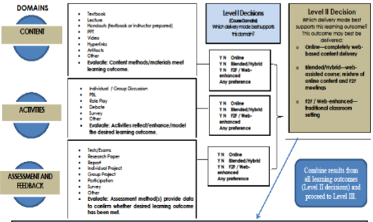
How should I offer this course: the online, hybrid or traditional models…
http://jolt.merlot.org/vol10no2/brinthaupt_0614.pdf
Notes:
How Should I Offer This Course? The Course Delivery Decision Model (CDDM)
Thomas M. Brinthaupt, Maria A. Clayton, Barbara J. Draude, Paula T. Calahan, MERLOT Journal of Online Learning and Teaching (JOLT), Jul 03, 2014
Commentary by Stephen Downes
This is not a bad paper though I wish the authors had been more imaginative in their typology of delivery models - the old "in-class, hybrid or online" classification could admit of much more nuance, ranging from pedagogical style (active learning, constructionism, lecture) through to media employed (videos, texts, simulations). There's a bit of that in the only substantive diagram of the model, which begins with sets of options for content, activities and feedback. But these seem placed squarely within an instructivist frame, and do not help guide delivery decisions in any substantive manner. I think the discussion is interesting, even though the model suffers from the flaws of models generally: people who understand the model don't need it, while people who need the model don't understand it.

Slide 14
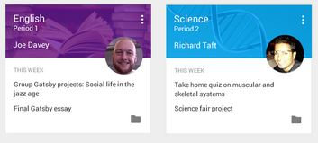
These models are being implemented as educational technology
Dozens of LMS companies are re-examining their business plans this week after the launch of Google's preview of Classroom, part of the Google Apps for Education suite.
http://googleblog.blogspot.ca/2014/05/previewing-new-classroom.html

Slide 15
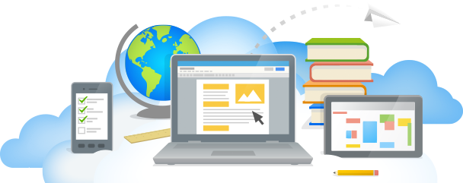
According to their official blog, Classroom helps teachers:
help teachers create and collect assignments
make announcements and ask questions
create folders for each assignment and for each student.
Image: http://www.google.com/enterprise/apps/education/
Notes:
Previewing a new Classroom
Zach Yeskel, Official Google Canada Blog, May 07, 2014
Commentary by Stephen Downes
Dozens of LMS companies are reexamining their business plans this week after the launch of Google's preview of Classroom, part of the Google Apps for Education suite. According to their official blog, Classroom helps teachers:
help teachers create and collect assignments paperlessly
make announcements, ask questions and comment with students in real time
creates Drive folders for each assignment and for each student. Students can easily see what’s due on their Assignments page.
Google says it wants the applications to "play well" with others. I'll believe that when I see that.

Slide 16

With models, the answers are determined before the system or simulation is ever run…
“Carnegie Melon University received a two-year grant for research on and development of MOOCs platforms 'intelligent enough to mimic the traditional classroom experience'.”
http://unescochair.blogs.uoc.edu/blog/2014/06/25/a-goal-for-google-and-carnegie-mellons-mooc-research/
Notes:
A Goal for Google and Carnegie Mellon´s MOOC Research?
Unattributed (UNESCO Chair in e-Learning), Education & Technology for Social Change, Jun 25, 2014
Commentary by Stephen Downes
This post summarizes: "Under the Google Focused Research Award program, Carnegie Melon University received a two-year grant for research on and development of MOOCs platforms 'intelligent enough to mimic the traditional classroom experience'." He then comments, "It remains unclear if the word choice was a mishap or the concept was fuzzy." There has been a lot of back-pedalling but I think the original statement was probably the most accurate expression of the intent, as educational institutions continue to resist any redefinition of learning. See also coverage in the Chronicle: "Unless the MOOCs pay attention to how people actually learn, they will not be able to improve effectiveness, and will end up as just a passing fad." Oooo, burn. I'm sure we all looked at the list of Google funded focused research awards.

Slide 17
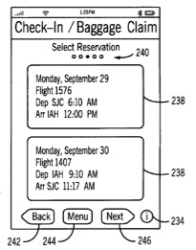
But it’s not new just because you’ve added “on a computer” to some pre-existing model or idea
The courts have spoken on this
https://www.eff.org/deeplinks/2014/06/bad-day-bad-patents-supreme-court-unanimously-strikes-down-abstract-software
Image: http://www.macrumors.com/2012/07/10/apple-wins-patent-for-nfc-enabled-itravel-transportation-ticketing-app/
Notes:
Bad Day for Bad Patents: Supreme Court Unanimously Strikes Down Abstract Software Patent
Daniel Nazer, Vera Ranieri, Electronic Frontier Foundation, Jun 20, 2014
Commentary by Stephen Downes
Nice news on the patent front. "Essentially, the Court ruled that adding “on a computer” to an abstract idea does not make it patentable. Many thousands of software patents—particularly the vague and overbroad patents so beloved by patent trolls—should be struck down under this standard."

Slide 18
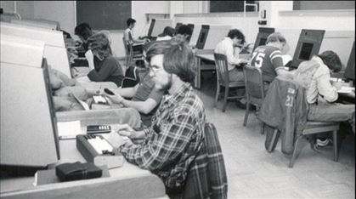
It’s not even new on a computer… today’s online learning models are yesterday’s models with new names
“This isn’t simply a matter of forgetting history -- the history of technology or the history of education or the history of ed-tech… It’s a rewriting of history” - Watters
http://hackeducation.com/2014/06/18/unfathomable-cetis2014/
Notes:
Un-Fathom-able: The Hidden History of Ed-Tech
Audrey Watters, Hack Education, Jun 22, 2014
Commentary by Stephen Downes
Not that we were first - I know we weren't - but we had been offering courses online for four years by the time "the first online class" (at, and according to, MIT) was offered. By 2001, actually, I had left Assiniboine, where we put the General Business Certificate courses online, and had been at the University of Alberta for two years, where we put a municipal government learning and resource portal online. So I can personally attest that the 'history' told by the founders of these new education ventures are works of fiction. This talk by Audrey Watters, by contrast, is not. It's the sober alternative to the hype.

Slide 19
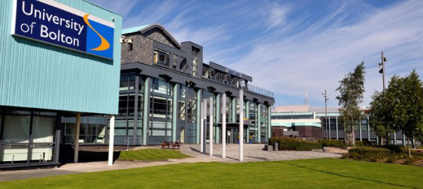
Take, for example, LRMI, a model of learning resources
You’ll recognize AICC, IMS, IEEE-LOM, SCORM, IMS-MLR…
http://blogs.pjjk.net/phil/lrmi-at-the-cetis-conference-2014/
Notes:
LRMI at the Cetis conference 2014
Phil Barker, Lorna Campbell, CETIS, Jun 24, 2014
Commentary by Stephen Downes
“What on Earth Could Justify Another Attempt at Educational Metadata?" That's the name of the first presentation in a set of presentations summarizing the involvement by CETIS in an initiative co-led Creative Commons and the Association of Educational Publishers, and funded by the Gates Foundation. This slide show is a partial history of metadata initiatives (it doesn't mention the Canadian East-West standards and the AICC specification)(see also What is schema.org? and my blog post on explaining the LRMI alignment object).
Another presentation from Phil Barker explains LRMI - "LRMI/schema.org metadata is deeply embedded in the web to the extent that it is right in the pointy brackets of the HTML code of web pages." There's also a presentation explaining an LRMI implementation by Google custom search. Then "Ben Ryan of Jorum discussed his work in implementing schema.org / LRMI in DSpace." Finally, Phil Barker gives " a short over view of some of the sites that we have found to be using LRMI because they show up in the Custom Search Engine results." Related: video on using schema.org to describe open educational resources.

Slide 20
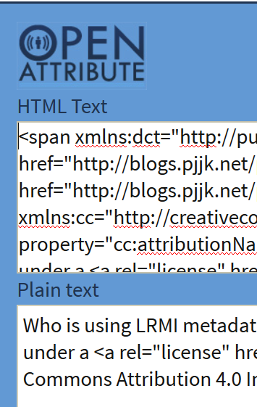
And the results are pretty much what you’d expect
This post offers a short selection of sites where it can be found. Despite Barker's qualification this seems to me to be a very short list.
http://blogs.pjjk.net/phil/who-is-using-lrmi-metadata/
Notes:
Who is using LRMI metadata?
Phil Barket, Sharing, Learning, Jun 26, 2014
Commentary by Stephen Downes
You may have heard of LRMI (Learning Resource Metadata Initiative) but you may not know who is using it. This post offers a short selection of sites where it can be found. Despite Barker's qualification ("there are others using LRMI properties in their webpages that I happened not to find (t.b.h. I didn’t spend very long looking) ") this seems to me to be a very short list.

Slide 21
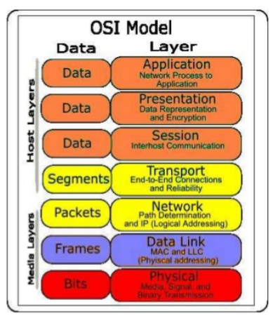
New versions of old models don’t produce new results
Phil Richards “highlighted the NHS as an example of a sector in which large sums of money had been invested in the development of interoperable systems based on open standards which had failed to deliver.”
http://ukwebfocus.wordpress.com/2014/06/30/the-city-and-the-city-reflections-on-the-cetis-2014-conference/

Slide 22
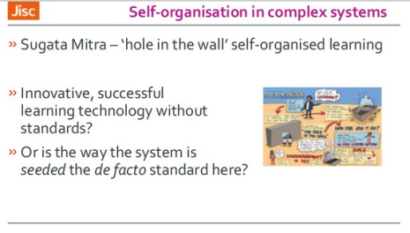
And maybe the ‘right model’ is to do away with the models altogether
It could be "non-standards based systems, such as “innovative, successful learning technology without standards” such as "Sugata Mitra's 'hole in the wall' work as an example of successful self-organised learning
http://www.slideshare.net/csmart36/phil-richards-keynote-cetis14
Notes:
The City and The City: Reflections on the Cetis 2014 Conference
Brian Kelly, UK Web Focus, Jun 30, 2014
Commentary by Stephen Downes
Summary and reflections on the 2014 CETIS conference that took place in Bolton a couple of weeks ago. Of note, from a talk by Phil Richards, "In the moves towards reducing the range of activities which Jisc works on Phil highlighted a move away from working with standards, and highlighted the NHS as an example of a sector in which large sums of money had been invested in the development of interoperable systems based on open standards which had failed to deliver." Note though that the alternative is not necessarily the employment of proprietary standards. It could be "non-standards based systems, such as “innovative, successful learning technology without standards” such as "Sugata Mitra's 'hole in the wall' work as an example of successful self-organised learning which we should seek to emulate."

Slide 23

What’s missing in the standard-based models-based approach is what we used to think of as BAD
Bricolage – the doesn’t allow or cater for bricolage.
Affordances – everage the technology to improve learning and teaching.
Distribution – implications for the institutional practice of e-learning."
http://davidtjones.wordpress.com/2014/03/31/bim-and-bad/
Notes:
BIM and BAD
David T. Jones, The Weblog of (a) David Jones, Apr 25, 2014
Commentary by Stephen Downes
I like this acronym - it's not complete, but it's a great start: "BAD is an acronym that captures what I think is missing from the institutional approach to university e-learning
Bricolage – the LMS as Enteprise Systems doesn’t allow or cater for bricolage.
Affordances – resulting in an inability to leverage the affordances of technology to improve learning and teaching.
Distribution – the idea that knowledge about how to improve L&T is distributed and the implications that has for the institutional practice of e-learning."
This wasn't what we were trying to develop when we developed MOOCs, but if this had been the description of what we were trying, it wouldn't have been far off.

Slide 24
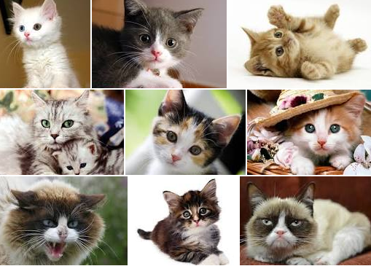
We need to question the presumption that we have too much or that it must be organized a certain way
Weinberger: We don't feel overloaded by the effects of 1.3 million apple pie recipes or 7.6 million cute cat photos. Why not?
http://www.hyperorg.com/blogger/2014/05/11/2b2k-in-over-our-heads-my-simmons-commencement-address/
Notes:
“In Over Our Heads” – My Simmons commencement address
David Weinberger, Joho the Blog, May 16, 2014
Commentary by Stephen Downes
David Weinberger hits the mark with this talk about information overload. We don't feel overloaded by the effects of 1.3 million apple pie recipes or 7.6 million cute cat photos. Why not? Because we're not expected to master them. But with information it's different, because there used to be so much less that we could master all the information. But not any more. "We’re all in over our heads. Forever. This isn’t a temporary swim in the deep end of the pool. Being in over our heads is the human condition." But hey - that's a good thing.

Slide 25
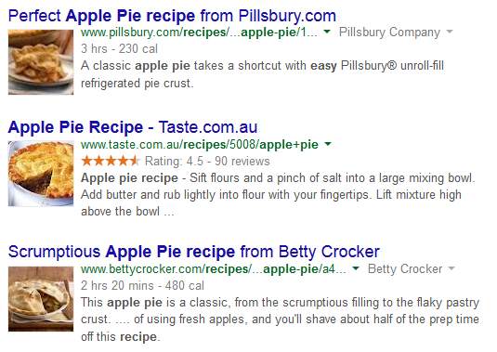
We’re not expected to master them. We’re expected to pick and choose and apply as needed

Slide 26
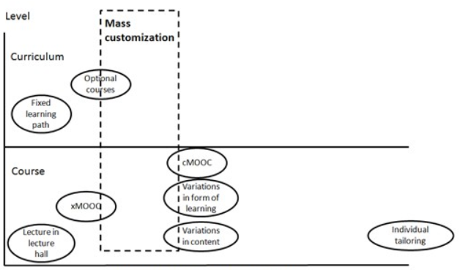
That’s the difference between personal learning and personalized learning
‘personalized’ is off-the-shelf and customized from a menu of options; ‘personal’ is made to order (and generally made by hand and made by and for oneself)
http://www.irrodl.org/index.php/irrodl/article/view/1704/2834
Notes:
Mass Customization of Education by an Institution of HE: What Can We Learn from Industry?
Robert Schuwer, Rob Kusters, International Review of Research in Open, Distance Learning (IRRODL), May 05, 2014
Commentary by Stephen Downes
So this seems like a good time to restate a distinction I've been using for some time now:
personalized - a common product is adapted for use by an individual
personal - a unique produced is created for and possibly by the individual
A similar distinction appears with similar terms. So, for example, a custom car is one that was built especially for you, while a customized car is a production-line car with features adjusted to your specification. And so on. That's why I say I am working on 'personal learning' rather than 'personalized learning'.
Why is this important? Because if you're not careful you'll fall into the error made by the authors of this paper as they try to create personal learning in the mould of mass customization (as, they say, it has been practised in other industries for years). So we get a picture of 'customized' learning where you, the learner, are essentially creating a learning design by picking from a menu of customization options. That's fine if you basically wanted to learn the same way as everyone else. But what if you wanted to improvise? Sorry, no options for that.

Slide 27
Institutions understand personalized. But they don’t understand personal.
“The widespread adoption of social media among students brings shared interactional practices that does not match university arrangements for learning.
“This, we argue, invites reappraisal of the framing of established educational practices and the metaphorical work that precedes it.”
http://www.networkedlearningconference.org.uk/abstracts/pdf/hannon.pdf
Notes:
Assembling University learning technologies for an open world: connecting institutional and social networks
John Hannon, Matthew Riddle, Thomas Ryberg, Proceedings of the 9th International Conference on Networked Learning 2014, May 07, 2014
Commentary by Stephen Downes
Perhaps this is why I understand traditional academics less and less as time goes by: "many academics still prefer - knowingly or otherwise - to replicate the ‘real’ in the virtual world, rather than unfetter themselves from tradition and the familiar and create new selves, constructs, relationships and opportunities for engagement." By contrast, I feel myself and my work adapting and growing as technology grows. So do students, which creates a growing challenge to institutions. "The widespread adoption of social media among students brings shared interactional practices that does not match university arrangements for learning. This, we argue, invites reappraisal of the framing of established educational practices and the metaphorical work that precedes it." From the double symposium on Actor Network Theory.
I should add, quoting from the article: "There are three observations or upshots from these cases:
the shift to student self-organisation is consistent with the informal practices and rhetoric of social media, with its continual work of relating (liking, updating) and crafting an identity in a “personalised network”
the mobile practices of informal, self-organised learning challenge the metaphors of bounded (regional) learning spaces
student social media practices overflow the framing of institutional learning environments."
It makes me think of the comment in the introduction to the symposium about the templates that "tightly controlled how papers were formatted: the fonts used, margins and spacing and other things.. to stop you from doing some things, including exactly what we are doing here: using a different font, different margins with a different justification..."

Slide 28

Autonomy, rather than control, is essential in education
Satel: Control is an illusion and always has been an illusion. It is a Hobbesian paradox that we cannot enforce change unless change has already occurred. Higher status—or even a persuasive presentation full of facts—is of limited utility.
http://blogs.hbr.org/2014/04/to-create-change-leadership-is-more-important-than-authority/
Image: Bill Eatterson http://en.wikipedia.org/wiki/Bill_Watterson
Notes:
To Create Change, Leadership Is More Important Than Authority
Greg Satell, Harvard Business Review Blogs, Apr 30, 2014
Commentary by Stephen Downes
Change the word 'change' to 'learning' and you have a good account of why autonomy, rather than control, is essential in education. "Control is an illusion and always has been an illusion. It is a Hobbesian paradox that we cannot enforce change unless change has already occurred. Higher status—or even a persuasive presentation full of facts—is of limited utility. The lunatics run the asylum, the best we can do as leaders is empower them to run it right."

Slide 29
The design theories are nothing more than abstractions of the actual process, that they are most useful as descriptions of what was done, as opposed to prescriptions of what should be done
"designers should aim and accept that design is often based on informed guessing."
http://flosse.blogging.fi/2010/12/27/designing-learning-tools-%E2%80%94-introduction-to-some-methodological-thoughts/
Notes:
Designing Learning Tools — Introduction to Some Methodological Thoughts
Teemu Leinonen, FLOSSE Posse, May 29, 2014
Commentary by Stephen Downes
Alex Hayes asked for my comments on this post following my digital research methodologies talk. Here's what I said about it back in 2010. My response today: I think that what's important here is to understand that the design theories are nothing more than abstractions of the actual process, that they are most useful as descriptions of what was done, as opposed to prescriptions of what should be done, that the design methodologies represent a palatte of possible approaches, and that (as the second principle states) "designers should aim and accept that design is often based on informed guessing."

Slide 30
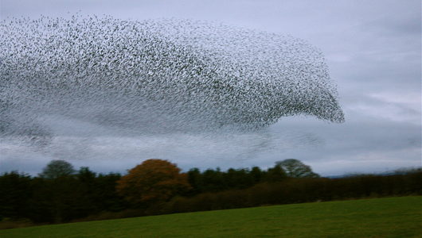
The personal isn’t designed. It is
based on self-organization
Each bird is actually reacting to the birds nearest to it, that the movement is the result of a series of short-range reactions... one bird's movement only affects its seven closest neighbors.
http://www.wired.com/2010/06/starling-physics/
http://www.pnas.org/content/early/2010/06/11/1005766107.abstract
Notes:
Amazing Starling Flocks Are Flying Avalanches
Brandon Keim, Wired, May 21, 2014
Commentary by Stephen Downes
I'm giving a talk on MOOC research on Friday, and while I've previously documented my thoughts on research methods (or the lack of same) the question nonetheless occurred to me, "how do you research chaotic systems like MOOCs?" Analytics aren't really useful, as numbers and quantities are essentially meaningless. Then I wondered, how do scientists research murmurations? These are flocks of songbirds that act as one fluid whole, like a network.
I'm still looking into it, but here are some things. This post gives the overview. "The secret lies in the same systems that apply to anything on the cusp of a shift, like snow before an avalanche, where the velocity of one bird affects the velocity of the rest. It is called 'scale-free correlation' and every shift of the murmuration is called a critical transition." Here's the paper. The topic is also covered by MNN, which makes the mechanics clear. "Each bird is actually reacting to the birds nearest to it, that the movement is the result of a series of short-range reactions... one bird's movement only affects its seven closest neighbors. So one bird affects its seven closest neighbors, and each of those neighbors' movements affect their closest seven neighbors and on through the flock."

Slide 31

The great wildebeest migration is a similarly unplanned event
“There is neither start nor finish to their endless search for food and water, as they circle the Serengeti- Mara ecosystem in a relentless sequence of life and death…”
http://www.maasaimara.com/entries/great-wildebeest-migration-maasai-mara
Notes:
Great Wildebeest Migration
Maasai Mara, May 21, 2014
Commentary by Stephen Downes
Following up on my murmuration post from yesterday, Keith Lyons writes to point me to studies of the Great Wildebeest Migration. "In reality there is no such single entity as ‘the migration’. The wildebeest are the migration – there is neither start nor finish to their endless search for food and water, as they circle the Serengeti- Mara ecosystem in a relentless sequence of life and death." What's interesting again is how we talk about this. Averages are not useful. "It is a dynamic process which defies predictions: no two years are ever quite the same."

Slide 32
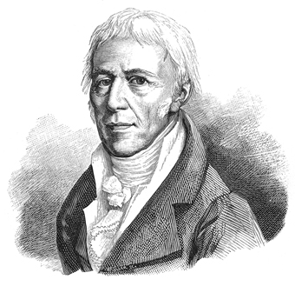
There is no single cause of events; landmark ideas are created by societies, not individuals
Charles Darwin’s grandfather, Erasmus, was also an evolutionist, as was this man, Jean Baptiste Lamarck.
http://hplusmagazine.com/2014/04/24/lamarckian-inheritance-passing-what-you-have-learned-to-your-children/
Notes:
Editor's Blog Lamarckian Inheritance: Passing what you have learned to your children
Josh Mitteldorf, Humanity+, Apr 28, 2014
Commentary by Stephen Downes
I'm still a step away from endorsing this argument, but it's interesting, and the background information is well worth knowing. The story is this: the idea of evolution was widely discussed long before Charles Darwin (including by his grandfather Erasmus) and by Jean Baptiste Lamarck. Unlike Darwin's theory, which suggests that natural selection works through random variation, Lamarckian evolution suggests that lifetime experiences also influence selection. Thus, for example, trauma in one generation results in physical effects over the next few generations. In this post, the evidence that there might actually be something correct in Lamarckian evolution is presented and discussed. Not only is this a fascinating read, it makes clear even (perhaps especially) landmark ideas are the not creation of one individual with one key book far ahead of anyone else, but rather, are the creation of a community over time.

Slide 33

Hashtags: categorizing using self-organizing networks rather than standard metadata and ontologies
Though commonly associated with Twitter, they existed before Twitter monetized them
http://tressiemc.com/2014/04/23/another-post-about-hashtags-no-seriously/
Notes:
Another Post about Hashtags. No, Seriously.
Tressie McMillan Cottom., tressiemc, Apr 23, 2014
Commentary by Stephen Downes
Insightful post about the role and use of hashtags. It's relevant because of the widespread use of hashtags in learning. Hashtags were (and are) produced not by individuals or corporations, but by communities. Though commonly associated with Twitter, they existed before Twitter monetized them, and would continue to exist even after the company discontinues their use (as some carefully placed 'rumours' have suggested). But in the spirit of 'there is utterly nothing that commerce does not foul' the discussion over hashtags has turned to their exploitation (by news and other content agencies) and they ownership (by the people who really created them but who are missing out on the exploitation). It's actually a pretty common phenomenon; hashtags are just the latest victim. #Jazz #Rap #MOOC

Slide 34
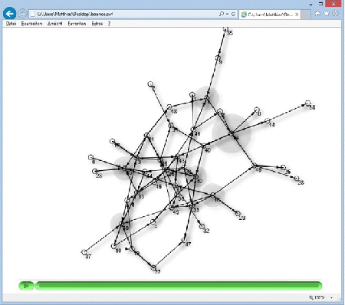
Hashtag networks can be seen as self-organizing ideas
A concept map isn't the same as a network. But insofar as concepts are dynamic, interacting things they can and do form networks.
http://x28newblog.wordpress.com/2014/04/25/conceptual-connections-once-again/
Notes:
Conceptual Connections, once again
Matthias Melcher, x28’s new Blog, May 09, 2014
Commentary by Stephen Downes
Concepts can form networks, says Matthias Melcher. "Words can change each other’s subtle nuances, for example when a newer word gradually displaces an older one from a certain meaning, while the older word slowly shifts its connotations, just by being used differently." I don't inherently disagree with this. I was pretty careful in my statement to allow for non-causal changes of state: "can cause or result in..." - and the purpose was precisely allow that networks could be formed by non-physical entities. Concepts may be one such example. Now I have said connections are not just relations between concepts, as Melcher notes here. A concept map isn't the same as a network. But insofar as concepts are dynamic, interacting things they can and do form networks.

Slide 35
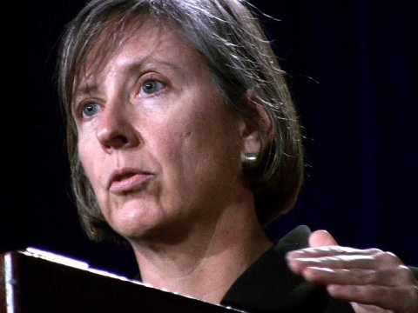
Mary Meeker…
The rise of mobile, the proliferation of apps... "the edge is becoming more important than the node"
http://www.businessinsider.com/mary-meekers-2014-internet-presentation-2014-5
Photo: J.D. Lasica
Notes:
Internet Trends 2014
Mary Meeker, Business Insider, May 31, 2014
Commentary by Stephen Downes
Mary Meeker's annual state of the internet report has come out and once again it is probably the most insightful snapshot of the state of play as you're going to see. My only complaint is that at 165 slides, it's too short. The trends won't be a surprise to anyone following the internet closely, but it's good to have real data to support beliefs about the rise of mobile, the proliferation of apps, etc. There are also some unexpected insights, such as "the edge is becoming more important than the node" in social graphs. Don't miss this one. Image: JD Lasica/Flickr

Slide 36
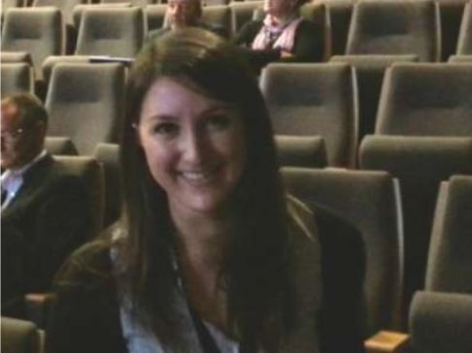
Students in academia: not the start of a trend, but the continuation of one
Even a search for Ed Tech student panels specifically yields more than 2,000 results. So I think that the trend is well-established;
http://mfeldstein.com/three-makes-movement-branson-creates-youth-panel-student-voice-ed-tech
Photo: student Rachel Winston, who gave a keynote address at Alt-C last year
Notes:
Three Makes a Movement: Branson creates youth panel for student voice in ed tech
Phil Hill, e-Literate, Jun 10, 2014
Commentary by Stephen Downes
While I am all in favour of student participation – including panels – at conferences, I really don’t think the more recent two events constitute the "start” of such a movement, as claimed by Phil Hill. A simple Google search on “student panel” (in quotes) yields 199,000 results. Even a search for Ed Tech student panels specifically yields more than 2,000 results. So I think that the trend is well-established; perhaps where it is new is among the 20MM and Branson Foundations of the world (which are often the last places to get it, and the first to claim credit). (Photo: student Rachel Winston, who gave a keynote address at Alt-C last year).

Slide 37
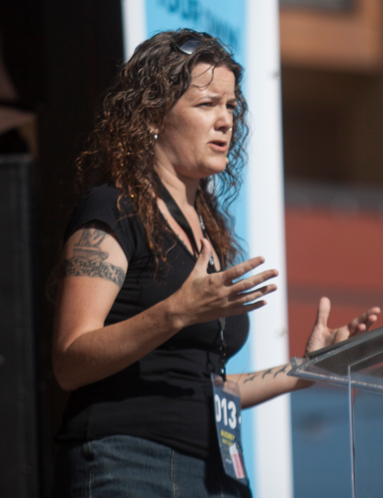
Watters: the future of ed tech is a reclamation project
“We can reclaim the Web and more broadly ed-tech for teaching and learning. But we must reclaim control of the data, content, and knowledge we create.”
http://www.hackeducation.com/2014/05/22/alberta-digital-learning-forum/
Photo: http://siliconslopes.com/2013/06/instructure-co-founder-apis-in-ed-tech-will-provide-open-dialogue/
Notes:
The Future of Ed-Tech is a Reclamation Project
Audrey Watters, Hack Education, May 28, 2014
Commentary by Stephen Downes
Quite a good talk from Audrey Watters a few days ago in Edmonton. This post is the (sparse) slide deck and the (rich) text transcript. The gist? "We can reclaim the Web and more broadly ed-tech for teaching and learning. But we must reclaim control of the data, content, and knowledge we create. We are not resources to be mined. Learners do not enter our schools and in our libraries to become products for the textbook industry and the testing industry and the technology industry and the ed-tech industry to profit from."

Slide 38

We are not resources to be mined. Learners do not enter our schools and in our libraries to become products for the textbook industry
Lucy Gray, who saw all of her Slideshare presentations deleted and her account closed without notice or explanation.
http://www.lucygray.org/weblog/2014/04/shame-on-slideshare-and-lessons-learned.html
Notes:
Shame on Slideshare and Lessons Learned
Lucy Gray, High Techpectations, Apr 30, 2014
Commentary by Stephen Downes
As readers know, I use Slideshare a lot - I was one of the very first users of the service (there was once a time when most presentations on Slideshare were mine!) and use Slideshare as an integral part of my presentation pages. So something like this is a worry - Lucy Gray saw all of her Slideshare presentations deleted and her account closed without notice or explanation. She has backups (phew!) but it's a major inconvenience. What's concerning is how arbitrary this was. Now I'm thinking seriously about a way to create my own embedded version of my presentations - anyone know how? - and dumping my Slideshare account.

Slide 39
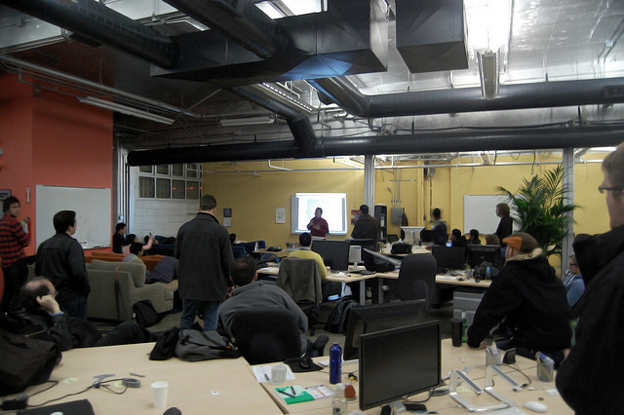
Known
“You can still share selfies, make friends, listen to music together and share links, but now you do it in a space that's really yours, and that you get to have more control over.”
http://withknown.com/
#indieweb
http://werd.io/2014/how-were-on-the-verge-of-an-amazing-new-open
Notes:
How we're on the verge of an amazing new open web #indieweb
Ben Werdmuller, Benwerd, Jun 03, 2014
Commentary by Stephen Downes
Ben Werdmuller may have a startup invested in the concept, but his view of an indieweb is sound and something I support (see also, "domain of one's own"). "The idea is simple: instead of everyone giving all their information to a site like Facebook, they keep it themselves, but still get to communicate easily using all of the great user experience discoveries we've made. You can still share selfies, make friends, listen to music together and share links, but now you do it in a space that's really yours, and that you get to have more control over."

Slide 40
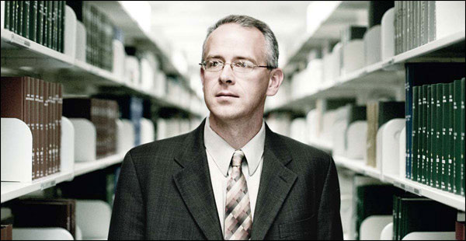
The silos of today will become the syndication endpoints of tomorrow
Publish (on your) Own Site, Syndicate Elsewhere”. .. The POSSE antimodel - promoted here through everything from #indiweb to Diaspora to app.net to syndication itself - that we've been taking about here for years.
http://opencontent.org/blog/archives/3393
Photo: http://education-portal.com/articles/Interview_with_David_Wiley.html
Notes:
Demoting Social Silos to Syndication Endpoints David Wiley discovers Known and the result is magical. "Known is a publication platform that uses the “POSSE” publication model, where POSSE stands for “Publish (on your) Own Site, Syndicate Elsewhere”. .. The POSSE model is just beautiful. It represents everything empowering about the Reclaim and Retain work. In fact, the more I wrapped my head around it, the more excited I got." See more about Known. This is the model - promoted here through everything from indiweb to Diaspora to syndication itself - that we've been taking about here for years. It's the basis for the personal learning environment. It's the basis for mesh networking. Welcome to the future, David. Maybe you want to read this (and this) and we can talk about breaking down the silos and building indie learning. Via Jim Groom.

Slide 41

“Starting now. A technology that allows for limitless reproduction of knowledge resources, instantaneous global sharing and cooperation, and all the powerful benefits of digital manipulation, recombination, and computation…” – Jim Groom
http://www.educause.edu/visuals/shared/er/extras/2014/ReclaimingInnovation/default.html
Notes:
Reclaiming Education
Jim Groom, Brian Lamb, EDUCAUSE Review, Jun 04, 2014
Commentary by Stephen Downes
I guess everybody knows I'm a fully paid up subscriber to this vision, and I really appreciate Jim Groom and Brian Lamb's statement of it: "Starting now. A technology that allows for limitless reproduction of knowledge resources, instantaneous global sharing and cooperation, and all the powerful benefits of digital manipulation, recombination, and computation must be a 'bag of gold' for scholarship and for learning." Be sure to look at the very top of the article for the link to case studies - otherwise you'll miss half of what's there. See also Groom's post on reclaiming innovation, which in turn contains some good videos, including this one from Audrey Watters and Kin Lane.

Slide 42
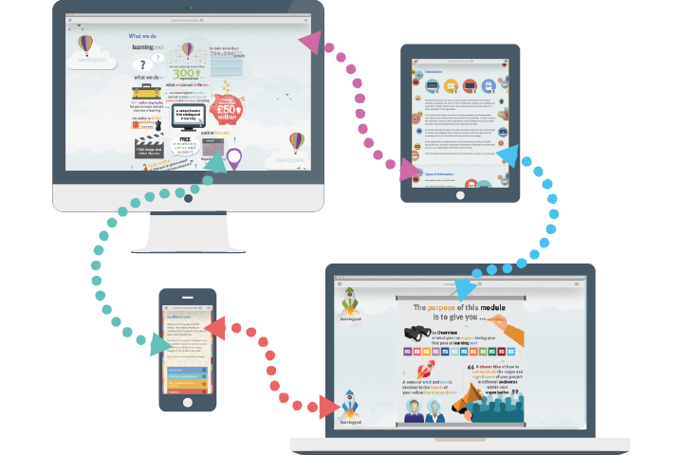
Learning reclaimed is network learning…
For example, Adapt Learning to develop a freely available authoring tool for organisations people that wish to develop their own responsive e-learning content..”
https://community.adaptlearning.org/
Notes:
Adapt Learning
Adapt Learning, Jun 12, 2014
Commentary by Stephen Downes
Interesting effort devoted to, as their website says, "create, as a community, the leading e-learning authoring tool for producing responsive content... to develop a freely available authoring tool for organisations that wish to develop their own responsive e-learning content... [and] to encourage a large, global community of end users and developers." Version 1.1 of their framework has just been released. Interestingly, the code available is all Javascript and Less (CSS). View the demo here. Adapt is an open source project established by City & Guilds Kineo, Learning Pool and Sponge UK.

Slide 43
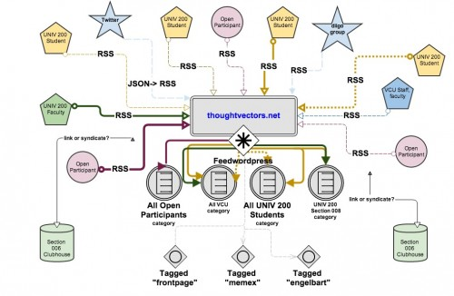
That’s what we were building when we were building something like this…
How to set up cMOOC-style website for your class
http://cogdogblog.com/2014/06/09/under-the-hood/
Notes:
Under the Hood of Thoughtvectors.net
Alan Levine, CogDogBlog, Jun 10, 2014
Commentary by Stephen Downes
Long, technical and very useful post (for those so inclined) on how to set up cMOOC-style website for your class. It's not an easy read but if you're looking to set something like this up using a WordPress installation, it even has script samples for useful functions (like how to find the RSS feed of a blog given the URL).

Slide 44

Some of the technology behind the reclaimed web…
“digital tools that will make it easier for readers to post comments and photos on news sites and to interact with journalists and each other."
http://www.washingtonpost.com/lifestyle/style/washington-post-new-york-times-and-mozilla-team-up-for-new-web-site-comment-system/2014/06/19/fa836e90-f71e-11e3-8aa9-dad2ec039789_story.html
Image: http://blog.wan-ifra.org/2014/06/23/washington-post-and-new-york-times-collaborate-with-mozilla-to-improve-online-comment-cul
Notes:
Washington Post, New York Times and Mozilla team up for new Web site comment system
Paul Farhi, Washington Post, Jun 20, 2014
Commentary by Stephen Downes
I want this: "The Washington Post, the New York Times and software developer Mozilla will team up to create digital tools that will make it easier for readers to post comments and photos on news sites and to interact with journalists and each other." People complain about the gRSShopper comment system more than anything else, but I've resisted focusing my energies on developing a centralized system. But this (as compared to the extant Disqus system) might be the ticket. More commentary: “The complicated thing about this is it’s going to be a lot of different pieces that need to be interoperable, and not just once, but across the web.” Mathew Ingram writes that it "sounds a little like an open-source version of Kinja." More from Poynter, Dave Winer (who argues for a more distributed system), Denovati.

Slide 45

Toolset: the Distributed Developer’s Stack (DDS)
they're built on distributed computing. Coursera, for example, relies on Amazon Web Services (AWS).
http://radar.oreilly.com/2014/05/beyond-the-stack.html
Notes:
Beyond the stack
Mike Loukides, O'Reilly Radar, May 30, 2014
Commentary by Stephen Downes
One of the interesting 'behind the scenes' things about the new MOOC platforms is the way they're built: distributed computing. Coursera, for example, relies on Amazon Web Services (AWS). EdX's default distribution also uses AWS. As tghe article states, "A new toolset has grown up to support the development of massively distributed applications. We call this new toolset the Distributed Developer’s Stack (DDS)." This article is a good overview of the new paradigm.

Slide 46
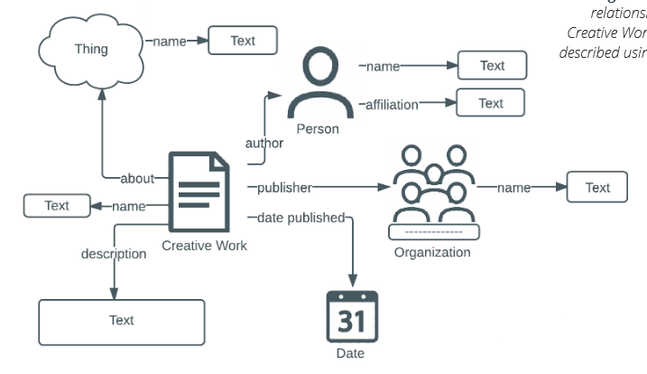
Schema.org – making it easier for search engines to index tour site
a joint initiative of the search engines Google, Bing, Yahoo and Yandex
http://publications.cetis.ac.uk/2014/960
Notes:
What is Schema.org?
Phil Barker, Lorna M. Campbell, CETIS, Jun 06, 2014
Commentary by Stephen Downes
Schema.org has been around for a while. But if you're not familiar with it, and need to know about web page indexing on a technical level, this is an important read. "Schema.org is a joint initiative of the search engines Google, Bing, Yahoo and Yandex aimed at making it easier to index web pages... This briefing describes schema.org for a technical audience. It is aimed at people who may want to implement schema.org markup in websites or other tools they build but who wish to know more about the technical approach behind schema.org and how to implement it."

Slide 47
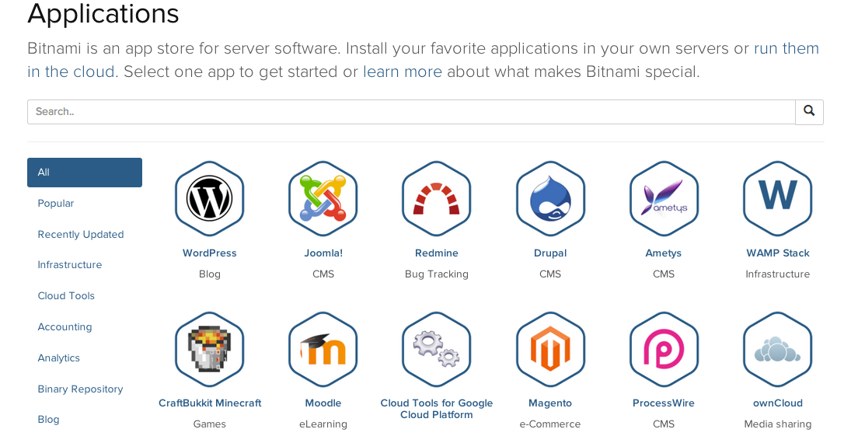
An app store for server software
Install your favorite applications in your own servers or run them in the cloud.
https://bitnami.com/stacks
Notes:
Bitnami
Bitnami, May 15, 2014
Commentary by Stephen Downes
This is very nice. "Bitnami is an app store for server software. Install your favorite applications in your own servers or run them in the cloud. Select one app to get started or learn more about what makes Bitnami special." No, it's not free (of course). There are demo modes, but they're short-lived. For your own cloud server you'll need to enter your Amazon Web Service credentials.
For more on this, see this great post from Jim Groom outlining how he created a Ghost service. He describes how it works: "AWS provides a relatively easy way to install an application like Ghost, which has unique server dependencies, by tapping into Amazon’s marketplace of Community Images. These are searchable, virtualized packages that take care of all the server settings for a given application, enabling you to get up and running quickly and easily."

Slide 48

Take back your data from Google
"a personal web server preloaded with open source software that lets you run your own web services from your home network.”
http://www.wired.com/2014/05/out-in-the-open-indie-box/
Notes:
Out in the Open: The Tiny Box That Lets You Take Your Data Back From Google
Klint Finley, Wired, May 12, 2014
Commentary by Stephen Downes
This article is basically a plug for a kickstarter product (pretty much everything in Wired is native advertising these days) but the concept is sound and a (more affordable) product like this will eventually bei in most homes, "a personal web server preloaded with open source software that lets you run your own web services from your home network–and run them with relative ease."

Slide 49
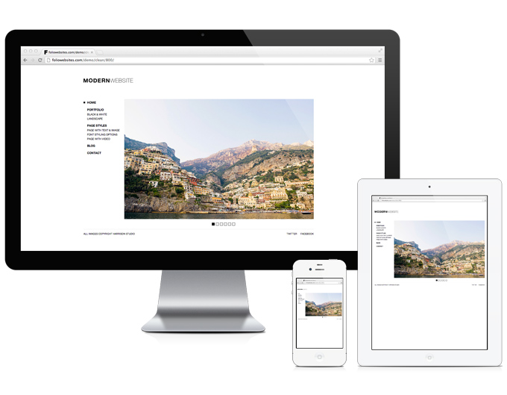
QR codes, open search, Windows Live tiles, touch icons for mobile and android, RSS autodiscovery, humans.txt – these are features of the modern website
http://www.labnol.org/internet/improve-website-tips/5007/
Image: http://foliowebsites.com/portfolio/modern/
Notes:
The 10 Things You Should Include In Your Website
Amit Agarwal, Digital Inspiration, Jun 25, 2014
Commentary by Stephen Downes
Oh, I hate list-based click-bait articles ('listicles') because they're just so much filler. But like a speckled trout I clicked on this one to see if I was on the list of '25 of the Best RSS Feeds for Educators' (spoiler: I'm not) and from that followed a link to another listicle, this one on ten things you should include in your website. This is actually a pretty good list, will make your site mobile-friendlier, and I especially like the idea of a humans.txt file.

Slide 50
How this changes learning: the theory of connectivism
“Connectivism repositions media as a type of content, in that media, as tools of cognitive engagement, have the potential to transform the content of learning.”
http://kelliralph.wordpress.com/2014/05/24/connectivism-informing-distance-education-theory-pedagogy-and-research/
Image: http://www.edrev21.com/2012/07/27/150/

Slide 51

What’s the connection between social networks and neural networks?
The Siemens answer is multimodal extension. The networks reach out and integrate with each other.
http://x28newblog.wordpress.com/2014/05/01/visualizing-my-understanding-of-connectivism/
Image: http://www.pcworld.com/article/239125/google_plus_day_24_is_google_plus_a_more_engaging_social_network.html
Notes:
Visualizing my understanding of connectivism
Matthias Melcher, x28’s new Blog, May 01, 2014
Commentary by Stephen Downes
Connectivism, as I describe it, suggests that there are different types of knowing networks. A human neural network is one. A society (or social network) is another. A neural net computer program is another. So far so good. But Geoff Cain asks the question: "how are these related? The recent criticisms show that it is difficult to reconcile these two." I would point out that there is no particular requirement that they be reconciled. It would be nice for us if they did, but it's not a priori necessary.
I think there are two answers, which I'll call 'the Downes answer' and 'the Siemens answer' because I've talked mostly about one and George has talked mostly about the other. These two are not mutually exclusive, they might both be true, and (probably) elements of both of them are, as they vary mostly from the perspective of point of view as opposed to postulation of a different causal mechanism.
The Siemens answer is multimodal extension. The networks reach out and integrate with each other. Thus, for example, a concept might be contained partially in a human brain but the full extension of the concept might extend beyond the network of neurons to include, and interact with (as part of the same network) extra-neural entities (like computers, other people, and the like).

Slide 52
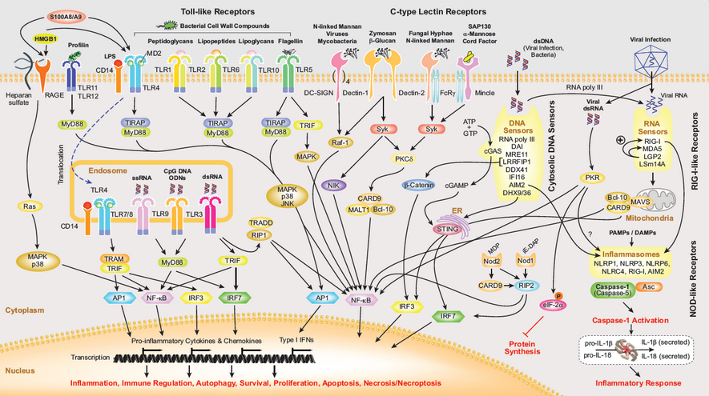
The Downes answer: pattern recognition. One network perceives patterns in another network and interprets or recognizes these patterns as something.
http://www.journals.elsevier.com/pattern-recognition/
Image: http://www.adipogen.com/media/Catalogs/Pix/Pattern_Recognition_Wallchart_Pix.PNG
Notes:
The Downes answer is pattern recognition (yes yes I know William Gibson wrote a book of that name, and that the concept is widely discussed by others). One network perceives patterns in another network and interprets or recognizes these patterns as something. So, for example, a social network might recognize 'genius' in a person via the presentation of patterns of behaviour by that person that cause responses typical of recognition of genius in society.

Slide 53
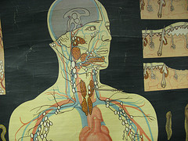
Connectivism as a learning theory
Cain writes, "for me, a theory must
account for current theories
sufficiently explain where we are now
make predictions
be subject to testing.”
http://cain.blogspot.ca/2014/04/why-connectivism-is-learning-theory.html
Image: Shira Golding http://cain.blogspot.ca/2013/07/oer-possible-resources-for-biology.html
Notes:
Why Connectivism is a Learning Theory
Geoff Cain, Brainstorm in Progress, May 01, 2014
Commentary by Stephen Downes
Yeah, this is kind of how I see it too: "Most of the criticisms I have read of Connectivism boil down to the new theory is not like the old theories." This is asserted in by Geoff Cain as he explains why the 'incompleteness' (David Wiley's concern) of connectivism doesn't mean it's not a theory. And this is useful: Cain writes, "for me, a theory must
account for current theories (either through refutation or inclusion)? A theory shouldn't just account for a given phenomena, it should do so in some measurably better way (more complete, elegant, etc.).
sufficiently explain where we are now.
make predictions. Any theory that can't predict anything is basically a conjecture at best.
be subject to testing. Here I would emphasize that the theory should change what we do based on experiment and empirical data.
In my experience, Connectivism has met those four conditions." Again - it doesn't matter to me whether or not connectivism is a theory, but these practical concerns - for example, whether ti explains, whether it predicts - are important.

Slide 54
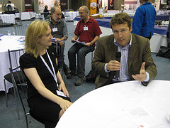
Connectivism’s respose: researching the MOOC
The MOOC was developed by Siemens and myself to instantiate the principles of connectivism
Our courses were designed as networks, testing both aspects of our theories
George Siemens (Photo credit: heloukee)
http://jolt.merlot.org/vol10no1/fournier_0314.pdf
http://cain.blogspot.ca/2012/10/moocs-and-connectivist-instructional.html
Notes:
Challenges to Research in MOOCs
Helene Fournier, Rita Kop, Guillaume Durand, MERLOT Journal of Online Learning, MERLOT Journal of Online Learning and Teaching (JOLT), Apr 30, 2014
Commentary by Stephen Downes
This is a paper published by my colleagues at NRC describing research on some of the MOOCs we've offered over the years here. "the authors report on an exploratory case study of PLENK, a connectivist-style MOOC, and highlight some of the challenges in the research and analysis process, especially as significant amounts of both quantitative and qualitative data were involved." Because of the lag-time in publication in academic journals, this work seems to me to be talking about older work, but in reality this research is at the forefront of our understanding of massive open online learning.

Slide 55
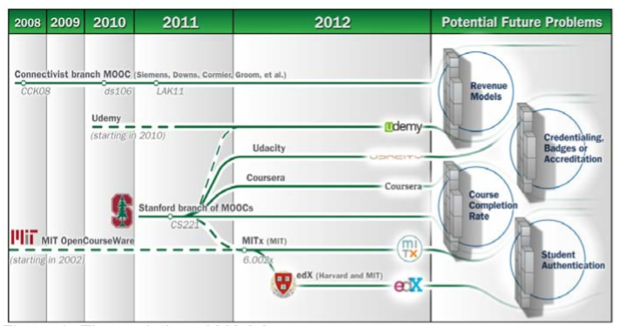
Participants’ perceptions in MOOCs
"creating networks and developing professional connections through networking technologies are advantages of participating in cMOOCs"
http://jolt.merlot.org/vol10no1/saadatmand_0314.pdf
Image: http://mfeldstein.com/four-barriers-that-moocs-must-overcome-to-become-sustainable-model/
Notes:
Participants' Perceptions of Learning and Networking in Connectivist MOOCs
Mohsen Saadatmand, Kristiina Kumpulainen, MERLOT Journal of Online Learning, MERLOT Journal of Online Learning and Teaching (JOLT), Apr 30, 2014
Commentary by Stephen Downes
I think the authors could have been a bit bolder in their conclusions ("creating networks and developing professional connections through networking technologies are advantages of participating in cMOOCs") but this paper for its own part offers an extensive set of references to primary and secondary MOOC literature from the first wave of discussion and studies (belying those who claim that there has been little or no research done on MOOCs thus far (yes, I still hear that at conferences)).

Slide 56
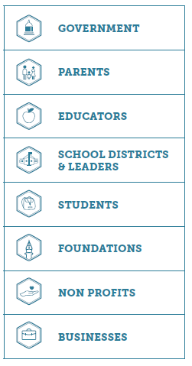
Where to now? The learner at the centre of the networked world
Aspen Institute:
empower learners to learn any time, any place
support and guide learners in a networked learning environment
interoperability across learning networks
http://aspeninstitute.fsmdev.com/documents/AspenReportFinalPagesRev.pdf
Notes:
Learner at the Center of a Networked World
Various authors, The Aspen Institute, Jun 19, 2014
Commentary by Stephen Downes
According to the prefix, "This report sets forth a vision that stems from the premise that the learner needs to be at the center of novel approaches and innovative learning networks." It identifies a pervasive probllem, the "silos" that make a learner-centered system difficult to implement. Here are their recommendations (abridged):
Redesign learning environments to empower learners to learn any time, any place.
Enhance the ability of educators to support and guide learners in a networked learning environment.
Build an infrastructure that will connect all students in all of the places they learn.
Support the maximum feasible degree of interoperability across learning networks.
Adopt policies to incorporate digital, media and social-emotional literacies as basic skills for living and learning in the digital age.
Create Trusted Environments for Learning.
Well here's the good news. This is exactly what our Learning and Performance Support Systems (LPSS) program is doing here at the National Research Council. I talk more about it here. We are staffed, well into the development process, and identifying partners for projects and collaborative research.

Slide 57
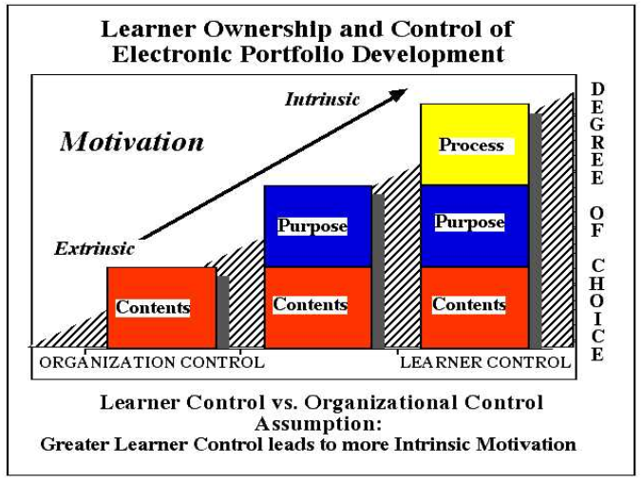
Learner control has moved beyond computer assisted programs…
“towards authentic learning contexts mediated by technology in which the learner may have a greater control of either tangible or intangible elements of a learning environment”
http://www.literacyandtechnology.org/uploads/1/3/6/8/136889/ib1.pdf
Notes:
Learner Control in Personal Learning Environments: A Cross- Cultural Study
Ilona Buchem, Gemma Tur Ferrer, Tobias Hölterhof, Journal of Literacy and Technology, Jun 03, 2014
Commentary by Stephen Downes
According to the authors, "research on learner control in context of PLE has moved beyond computer assisted programs, intelligent tutoring systems and learning management systems towards authentic learning contexts mediated by technology in which the learner may have a greater control of either tangible or intangible elements of a learning environment." This paper develops that research, looking at degrees of perceived personal ownership in cross-cultural settings. The paper is from a special issue of the Journal of Literacy and Technology on personal learning environments.

Slide 58
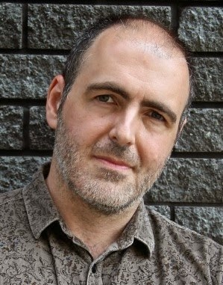
Reading and networking will become one and the same thing
Utopia developer Steve Pettifer
for instance, when a document in Utopoa is opened, "a sidebar opens up on the right-hand side and fills with relevant data from external databases and services like Mendeley, SHERPA/RoMEO, and Wikipedia."
http://poynder.blogspot.co.uk/2014/06/interview-with-steve-pettifer-computer.html
Notes:
Interview with Steve Pettifer, computer scientist and developer of Utopia Documents
Richard Poynder, Open, Shut?, Jun 02, 2014
Commentary by Stephen Downes
As this article notes, "Critics of the PDF also dislike the fact that it permits only passive reading. This means that scientists are not fully able to exploit the dynamic and linked nature of the Web." It seems like a small thing - and in the world of HTML I guess it is - but the world of PDF readers is beginning to move into the real of interaction with live data (including tables and references) with Utopia Documents, developed in 2009 and being released as open source software this week. So, for instance, when a document in Utopoa is opened, "a sidebar opens up on the right-hand side and fills with relevant data from external databases and services like Mendeley, SHERPA/RoMEO, and Wikipedia." This post interviews Utopia developer Steve Pettifer.

Slide 59
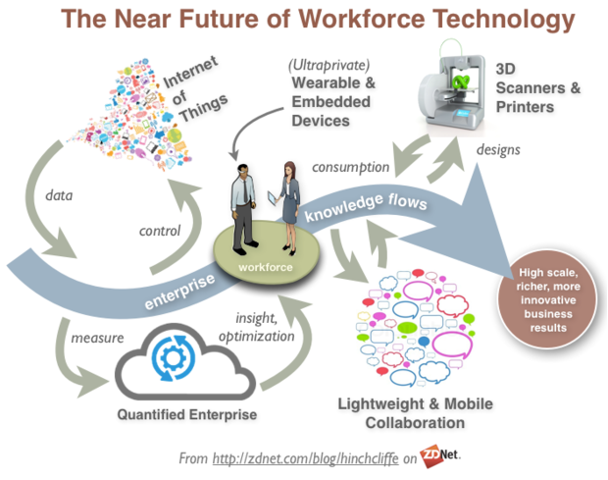
Connective learning technology is already transforming the workplace
“Combine ambient data on just about any physically manufactured object with pervasive wearable technologies that constantly present us with dashboards, notifications, analyses, and visualizations of all this data…”
http://www.zdnet.com/emerging-tech-is-transforming-the-workplace-7000028960/
Notes:
Emerging tech is transforming the workplace
Dion Hinchcliffe, ZD Net, May 05, 2014
Commentary by Stephen Downes
In this post Dion Hinchcliffe has a nice graphic illustrating the process described in the following (probably correct) prediction: "Combine ambient data on just about any physically manufactured object — from car tires and milk cartons to shipping containers and test tubes — with pervasive wearable technologies that constantly present us with dashboards, notifications, analyses, and visualizations of all this data, and you have a workplace that will rapidly turn into a contemporary cybernetic amagamation that was previously only the purview of science fiction." Via Harold Jarche.

Slide 60

Teams and collaborations will be transformed into networks and cooperatives
For example, the "oscillation principle" where developers meet three times a year for three days.
The rest of the time "team members are … using various forms of social media.
http://www.nancydixonblog.com/2014/05/-proquest-case-study-using-the-oscillation-principle-for-software-development.html
Notes:
ProQuest Case Study: Using the Oscillation Principle for Software Development
Nancy Dixon, Conversation Matters, Jun 11, 2014
Commentary by Stephen Downes
This is an interesting and extended look at the software development methodology employed by ProQuest (you may have seen their online maps). They use what Dixon calls the "oscillation principle" meeting three times a year for three days. The rest of the time "team members are in constant communication with each other using various forms of social media. They Scrum several times a week over Google Hangout or Skype, hold Hangout meetings between individual members or small groups to address problems, and use Flowdock as their group chat room." Process matters. In software development, process really matters.

Slide 61
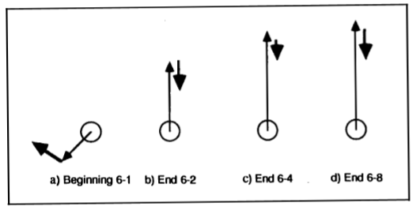
Interactions in a problem space
“Cooperative work is accomplished by the division of labour among participants, as an activity where each person is responsible for a portion of the problem solving.”
http://umdperg.pbworks.com/f/RoschelleTeasley1995OCR.pdf
Notes:
The Construction of Shared Knowledge in Collaborative Problem Solving
Stephanie D. Teasley, Jeremy Roschellel, The Conslruction of Shared Knowledge, May 20, 2014
Commentary by Stephen Downes
"Collaboration is a coo rdinated, synchronous activity that is the result of a continued attempt to construct and maintain a shared conception of a problem... Cooperative work is accomplished by the division of labour among participants, as an activity where each person is responsible for a portion of the problem solving." What's important in collaboration is the creation of a shared model. "Our perspective has characterised collaboration as a process of constructing and maintaining a Joint Problem Space." See also, Paul Brna, Models of Collaboration.

Slide 62
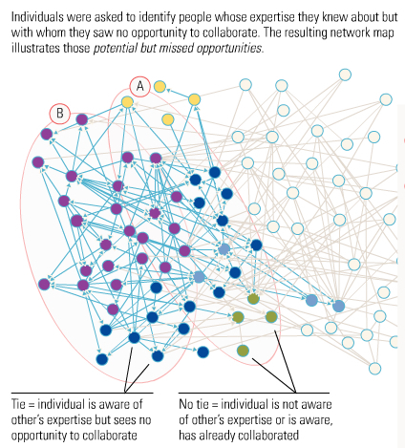
In cooperation, we no longer share models, designs, visions, goals, or objectives
"virtual distance had significant influences on trust, goal clarity and OCB and indirectly influenced innovation and success."
http://seapointcenter.com/cooperation-teamwork-and-collaboration/
Notes:
Let's Stop Confusing Cooperation and Teamwork with Collaboration
Jesse Lyn Stoner, Seapoint Center, May 21, 2014
Commentary by Stephen Downes
Short article with clear useful definitions and which looks at the impact of distance on cooperation and collaboration. The impact on cooperation is clear, from this study: "virtual distance had significant influences on trust, goal clarity and OCB and indirectly influenced innovation and success." But simply moving people to the same place will not impact collaboration (contra Marissa Mayer). "Collaboration is working together to create something new in support of a shared vision. The key points are that is is not an individual effort." True. But is this? "Collaborative leadership is based on respect, trust and the wise use of power. Leaders must be willing to let go of control."

Slide 63
Axelrod: Cooperation does not require centrality, commonality, management, control or even trust
It requires only a durable relationship… a network infrastructure
Which is a good thing, because my most useful cooperations are with those I trust least
http://www-ee.stanford.edu/~hellman/Breakthrough/book/pdfs/axelrod.pdf
Notes:
The Evolution of Cooperation
Robert Axelrod, May 20, 2014
Commentary by Stephen Downes
From the perspective of game theory, Robert Axelrod asks, "Under what conditions will cooperation emerge in a world of egoists without central authority?" Cooperation can develop even among people with competing agendas (as in, for example, a war). "Cooperation can get started, evolve, and prove stable in situations which otherwise appear extraordinarily unpromising." Axelrod suggests (and I disagree) that cooperation requires conditions of reciprocity among people likely to meet again: "The foundation of cooperation is not really trust, but the durability of the relationship." (I disagree because cooperation can occur altruistically, in a community of strangers).

Slide 64
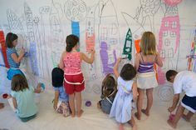
Cooperation means working with others without all the overhead
“Cooperation can be achieved if all participants do their assigned parts separately and bring their results to the table; collaboration, in contrast … involves negotiations, discussions, and accommodating others’ perspectives.”
http://www-ee.stanford.edu/~hellman/Breakthrough/book/pdfs/axelrod.pdf
Image: http://www.pinterest.com/explore/overhead-projector/
Notes:
Towards Better Group Work: Seeing the Difference between Cooperation and Collaboration
Olga Kozar, English Teaching Forum, May 20, 2014
Commentary by Stephen Downes
"Cooperation can be achieved if all participants do their assigned parts separately and bring their results to the table; collaboration, in contrast, implies direct interaction among individuals to produce a product and involves negotiations, discussions, and accommodating others’ perspectives." Olga Kozar, English Teaching Forum (2010). Is collaboration a reasonable goal? Dividing students into groups and telling them to work together is no guarantee that they actually will. Kreijns, Kirschner, and Jochems (2002) also point to "the social-psychological/social dimension of social interaction that is salient in non-task contexts."

Slide 65
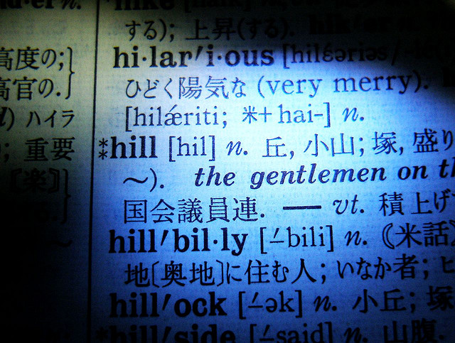
The new skills are network skills
You need to understand the real meaning of such arcania as lists, loops and APIs.
http://onlinejournalismblog.com/2014/05/09/coding-for-journalists-10-programming-concepts-it-helps-to-understand/
Notes:
Coding for journalists: 10 programming concepts it helps to understand
Paul Bradshaw, Online Journalism Blog, Jun 01, 2014
Commentary by Stephen Downes
This article won't teach you how to program - not even close. But if you're involved in any discipline employing computer technology - such as online learning - then the language of programming seeps into everyday language. That's where this article comes in - it will help you understand the real meaning of such arcania as lists, loops and APIs. Why does this matter? Because these terms have specific and precise meanings when used by programmers. Take 'objects', for example. To a layperson, a 'learning object' is more or less the same in meaning as, say, a 'learning thing'. But to a programmer, an 'object' is like a template with built-in functions. A 'learning object' is a piece of code that can be customized for specific applications. The implications of this difference shaped our understanding of online learning for a decade.

Slide 66

People forget about Codeacademy… ‘the other MOOC’
"The problem with MOOCs, according to Codecademy founder Zach Sims, is that they simply try to replicate the offline learning experience. The web presents the opportunity to learn in an entirely new way, he says."
http://tech.fortune.cnn.com/2014/04/23/with-24-million-students-codecademy-revamps-its-offerings/?section=magazines_fortune
Notes:
With 24 million students, Codecademy revamps its offerings
Erin Griffith, CNN.com - Money, Apr 24, 2014
Commentary by Stephen Downes
People forget about CodeAcademy when they talk about MOOCs, but it was earlier than most and, with 24 million users, larger than most. It has distanced itself (quite rightly) from the xMOOCs offered at Stanford and elsewhere. "The problem with MOOCs, according to Codecademy founder Zach Sims, is that they simply try to replicate the offline learning experience. The web presents the opportunity to learn in an entirely new way, he says." Quite so. This year it will begin monetizing, not by selling certificates to students, but by matching students with jobs (circumventing the whole certification process entirely). When you stop thinking that you're a university, a world of opportunity opens up to you.

Slide 67
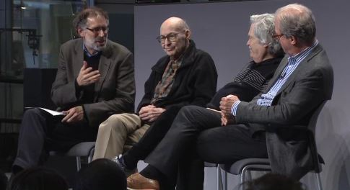
People, passion and play
Nicholas Negroponte, Alan Kay, and Marvin Minsky and Mitchel Resnick
The Media Lab model of "projects and peers and passion and play" grew out of Papert's work
http://www.media.mit.edu/video/view/spring14-2014-04-24-4
Notes:
Learning from Seymour Papert
Mitchel Resnick, Nicholas Negroponte, Alan Kay, Marvin Minsky, MIT Media Lab, May 05, 2014
Commentary by Stephen Downes
Recent MIT Media Lab event on the life and lessons of Seymour Papert, with contributions from Nicholas Negroponte, Alan Kay, and Marvin Minsky and Mitchel Resnick. 61 minute video. There's a Japanese translation. The Media Lab model of "projects and peers and passion and play" grew out of Papert's work, we are told. Mitchel Resnick introduces the panel.

Slide 68

The Superuniversity
We are being told “future universities will be rewarded by governments for their performance in economic development, employability of graduates, immigration and commercialisation of research.”
http://www.cbu.ca/sites/cbu.ca/files/a-university-as-it-might-be.pdf
Notes:
Cape Breton University President Looks Toward Super University
David Wheeler, Cape Breton University, Jun 17, 2014
Commentary by Stephen Downes
Presentation slides and press release about a talk by Cape Breton University president David Wheeler. He argues that " future universities will be rewarded by governments for their performance in economic development, employability of graduates, immigration and commercialisation of research in addition to more traditional metrics which may have less to do with scientific, social and cultural excellence or economic prosperity." One slide points out that universities have survived since the 16th century "because societies need them."
It is worth asking at this juncture exactly what it is that societies need. The citizens of Leiden famously opted for a university as a reward from William of Orange instead of the economic advantage of tax-free status. The citizens of Tubingen famously rejected industrial development in favour of remaining a university city. The need is to develop a university as a university, not an engine to support day-to-day economic development. If we want job creation or economic development we have the private sector to do that; if they won't (and in Canada, increasingly, they won't) we need other measures to address that; converting universities into something they're not is not the answer.

Slide 69
One slide points out that universities have survived since the 16th century "because societies need them."
What Is that what we need?
More designs and models?
More standards and measurement?
More centralization and control?
The same mistakes, repeated again?

Slide 70
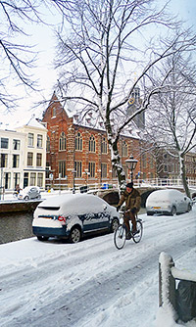
It is worth asking at this juncture exactly what it is that societies need
The citizens of Leiden famously opted for a university as a reward from William of Orange instead of the economic advantage of tax-free status. The citizens of Tubingen famously rejected industrial development in favour of remaining a university city.
http://law.leiden.edu/elmc/lu/leiden-university.html
https://www.uni-tuebingen.de/en/university.html

Slide 71

We have an alternative for today’s society
We can reclaim learning
Image: http://bavatuesdays.com/reclaim-hosting-is-live/

Slide 72
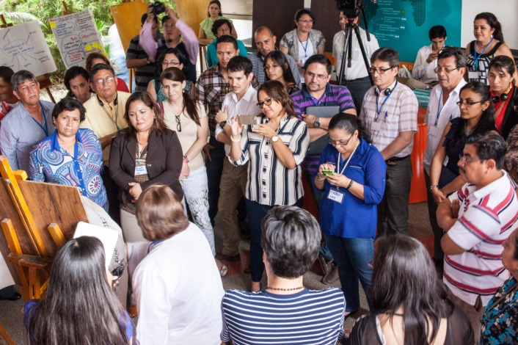
We are moving beyond institutions… toward a cooperative knowing society based on network knowledge
activities that will promote extending learning beyond formal education.
http://www.educationfutures.com/2014/05/01/building-a-knowmad-society-in-ecuador/
Notes:
Building a Knowmad Society in Ecuador
John W. Moravec, Education Futures, May 28, 2014
Commentary by Stephen Downes
I think this is an ambitious plan and wonder how it will impact the work that follows: "The project seeks to encourage horizontalized, peer-to-peer exchange and the development of activities that will promote extending learning beyond formal education. Nine three-day workshops will cover each regional division of Ecuador. An online platform will facilitate further discussion, and the outputs from the workshops and online activities will be fed into a data analysis process that will inform the creation of a white paper on transforming Ecuadorian education for a 'knowmadic' society."
Do also read the comment that follows the article. A writer named Khuyana offers, "I would like to ensure that these great changes apply to ALL universities in Ecuador, not just the 'new and improved' universities like Yachay University or IKIAM, as it seems to be so far." It points to the difficulties of aiming at 21st century objectives in institutions struggling to meet 20th century standards.

Slide 73

There is this tendency to suggest that the number of universities will dwindle to a very few. But in fact, universities will proliferate. They will be accessible and available, and number in the hundreds of thousands, not in the dozens. What will change is that universities will no longer be bastions of privilege and elitism.
http://halfanhour.blogspot.ca/2014/06/new-learning.html
Notes:
New Learning
Stephen Downes, Half an Hour, Jun 12, 2014
Commentary by Stephen Downes
A recent post describes "8 Ideas That Will Permanently Break Education As We Know It," by Terry Heick in TeachThought. Sheila Stewart addresses one of these points, the idea that 'parents are the sleeping giants' in education. "Hopefully parents can also work with teachers, principals and policymakers," she writes, rather than "redirecting anger." I address the rest. It's a good overview of the ways education is changing, but it subtly misses the point item by item. This post is my response to those items, creating an overview of what might be called New Learning.

Slide 74
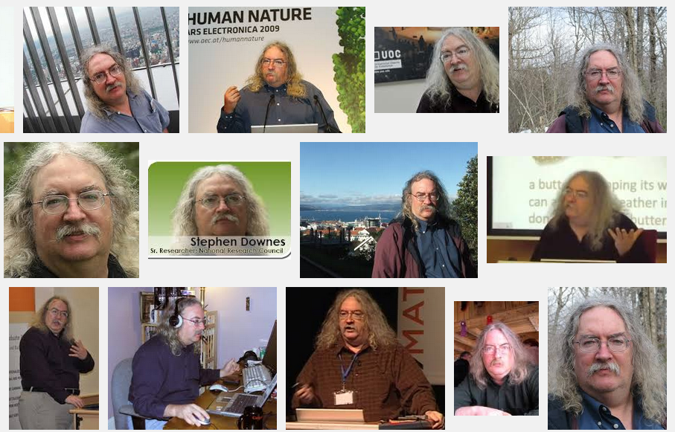
Stephen Downes http://www.downes.ca

